Slide 1
TIME SERIES-BASED FORECASTING
STUDY CASE
FENG YUAN
NOV 15, 2023
Notes:
Good Afternoon, This is Feng Yuan.

Slide 2

Outline
PROJECT DESCRIPTION
AAGR & CAGR CALCULATION
TREND ANALYSIS & FORECAST
CHALLENGES & PROJECT REVIEW
Notes:
My presentation have 4 parts：
1）problem description
2) Historical data analysis
3) Trend analysis & forecasting
4) Challenges & solutions

Slide 3
1
PROJECT DESCRIPTION
Part
Notes:
首先来看第一部分，Problem description

Slide 4
1
PROJECT DESCRIPTION
Data Set
Questions
Data Type
Period: %Y-%m
International Passengers: Int
Domestic Passengers: Int
Total Passengers: Int
Calculating the average annual growth rate of total passengers for 2008-2022
Forecasting passenger traffic for the next 10 years
Analyzing optimization ideas and challenges
Data Structure
Time series-based passenger flow data（Tableau, ARIMA or SARIMA？）
Data integrity：Null value？
Granularity of the data: Pivot Table
This is a typical time series-based analysis case.
Tools: Tableau, Python, Excel

Slide 5
2
AAGR & CAGR
CALCULATION
Part

Slide 6
1
METHOD
AAGR
CAGR
AAGR = Σ(annual growth rates) / number of years
Not considering compound interest
CAGR = ( (Ending Value / Beginning Value)^(1 / Number of Periods) - 1 ) * 100
Considering compound interest
Year | Total Passengers | AGR | AAGR | CAGR
2019 | 75,062,047 |  | 9.52% | -0.76%
2020 | 39,364,990 | -47.56% | 9.52% | -0.76%
2021 | 62,465,756 | 58.68% | 9.52% | -0.76%
2022 | 73,362,946 | 17.45% | 9.52% | -0.76%
Considering the unusual fluctuations in the data, CAGR could provide a more precise depiction of passenger traffic trends.
Notes:
平均增长率是一个aggregate calculation，用来描述 trends by time periods
这里重点涉及两个指标：
AGR：年度增长率，当前值对比过去值获得
AAGR：各年度增长率之和/N， N为时间跨度。average of AGR
CAGR：CAGR=(期末值​/期初值)^(1/n)​−1
The CAGR calculation formula could divided into 3 steps：
1）Ending Value (EV) divided by Beginning Value (BV)
2）Step 1‘s results raised to the power of 1/n（one over n）
3）Step 2’s results subtracted 1

Slide 7
2
RESULTS
4.05%
1.81%
Year | Total Passengers | AGR | AAGR | CAGR
2008 | 57,093,187 |  | 4.05% | 1.81%
2009 | 56,030,457 | -1.86% | 4.05% | 1.81%
2010 | 56,905,066 | 1.56% | 4.05% | 1.81%
2011 | 57,806,151 | 1.58% | 4.05% | 1.81%
2012 | 58,591,842 | 1.36% | 4.05% | 1.81%
2013 | 60,436,365 | 3.15% | 4.05% | 1.81%
2014 | 63,882,643 | 5.70% | 4.05% | 1.81%
2015 | 65,283,487 | 2.19% | 4.05% | 1.81%
2016 | 65,598,618 | 0.48% | 4.05% | 1.81%
2017 | 67,092,764 | 2.28% | 4.05% | 1.81%
2018 | 69,112,224 | 3.01% | 4.05% | 1.81%
2019 | 75,062,047 | 8.61% | 4.05% | 1.81%
2020 | 39,364,990 | -47.56% | 4.05% | 1.81%
2021 | 62,465,756 | 58.68% | 4.05% | 1.81%
2022 | 73,362,946 | 17.45% | 4.05% | 1.81%
Notes:
这里重点涉及三个指标：
AAGR：4.05%
CAGR：1.81%
AAGR：各年度增长率之和/N， N为时间跨度。average of AGR
CAGR：CAGR=(期末值​/期初值)^(1/n)​−1
The CAGR calculation formula could divided into 3 steps：
1）Ending Value (EV) divided by Beginning Value (BV)
2）Step 1‘s results raised to the power of 1/n（one over n）
3）Step 2’s results subtracted 1

Slide 8
3
TREND ANALYSIS
& FORECAST
Part
Notes:
下面，来看第3 部分：数据模型的选择与分析

Slide 9
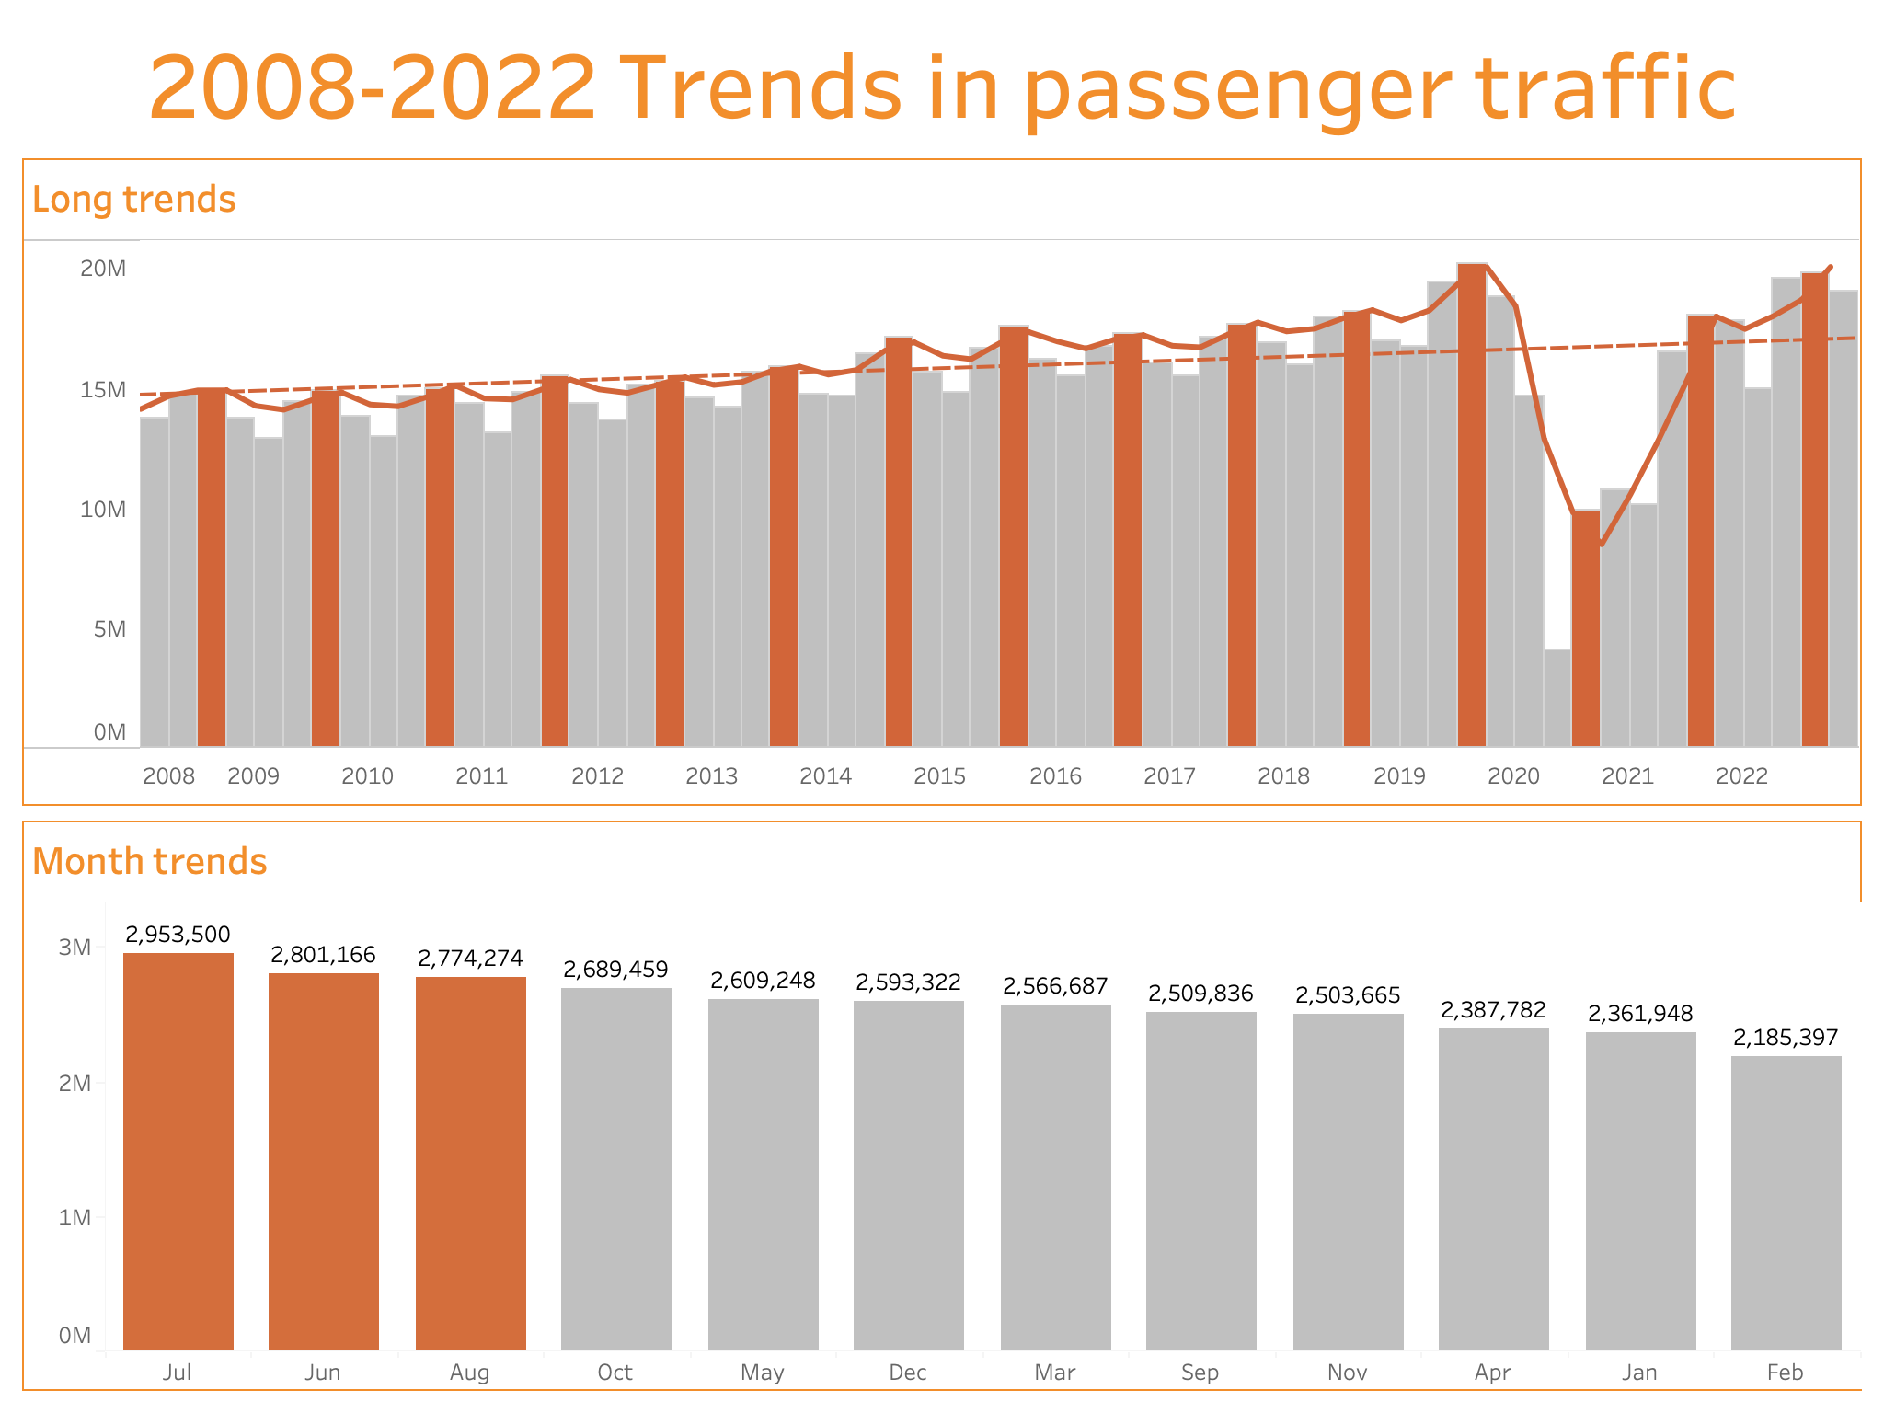
1
HISTORICAL DATA ANALYSIS
Long-term Trends
Passenger traffic shows an upward trend
COVID-19
3rd Quarter
Seasonal Fluctuations
Highest season: The 3rd quarter
Top 3 months: JUL, JUN, AUG
Abnormal Event
COVID-19
JUL
JUN
AUG
Highest month
Considering these features helps us to choose the best analytical model and
improve the accuracy of our predictions.
Notes:
数据集包含了按月记录的旅客数量，这为我们提供了时间序列数据分析的基础。在选择合适的预测模型前，我们需要考虑以下几点：
1. **趋势**：长期内，旅客流量可能呈现上升或下降的趋势。
1. **数据的周期性**：旅客流量数据可能会显示出明显的周期性，例如，季节性变化可能会影响旅客数量。最高月份，july， june， August
3. **外部因素**：经济条件、事件或灾难（如大规模流行病）可能会影响旅客流量。

Slide 10



2
MODEL SELECTION
For time series data with seasonality.
SARIMA
Seasonal ARIMA
For non-seasonal time series data, it is not effective for data with seasonality.
For data with trends,
the newer the value, the greater the weight.
ARIMA
Autoregressive Integrated
Moving Average
Tableau
Exponential Smoothing
Model
Notes:
SARIMA（Seasonal Autoregressive Integrated Moving Average）和ARIMA（Autoregressive Integrated Moving Average）都是用于时间序列分析和预测的统计模型。其区别在于：
ARIMA：主要用于分析和预测非季节性时间序列数据，即不受季节性影响的数据。
SARIMA：SARIMA模型用于分析和预测具有季节性的时间序列数据，即数据具有明显的季节性因素。同时，我们还可以将covid 19作为外部变量加入到预测因子，更有效地预测未来趋势。
Tableau所采取的是指数平滑模型从某一固定时间序列的过去值的加权平均值，以反复运算方式预测该系列的未来值。最简模型（简单指数平滑）从上一个实际值和上一个层次值来计算下一个层次值或平滑值。该方法之所以是指数方法，是因为每个层次的值都受前一个实际值的影响，影响程度呈指数下降，即值越新权重越大。
Exponential Smoothing A model that predicts the future values of a fixed time series。The method is exponential because the value of each level is influenced by the previous actual value in an exponentially decreasing manner, i.e., the newer the value the greater the weight.

Slide 11
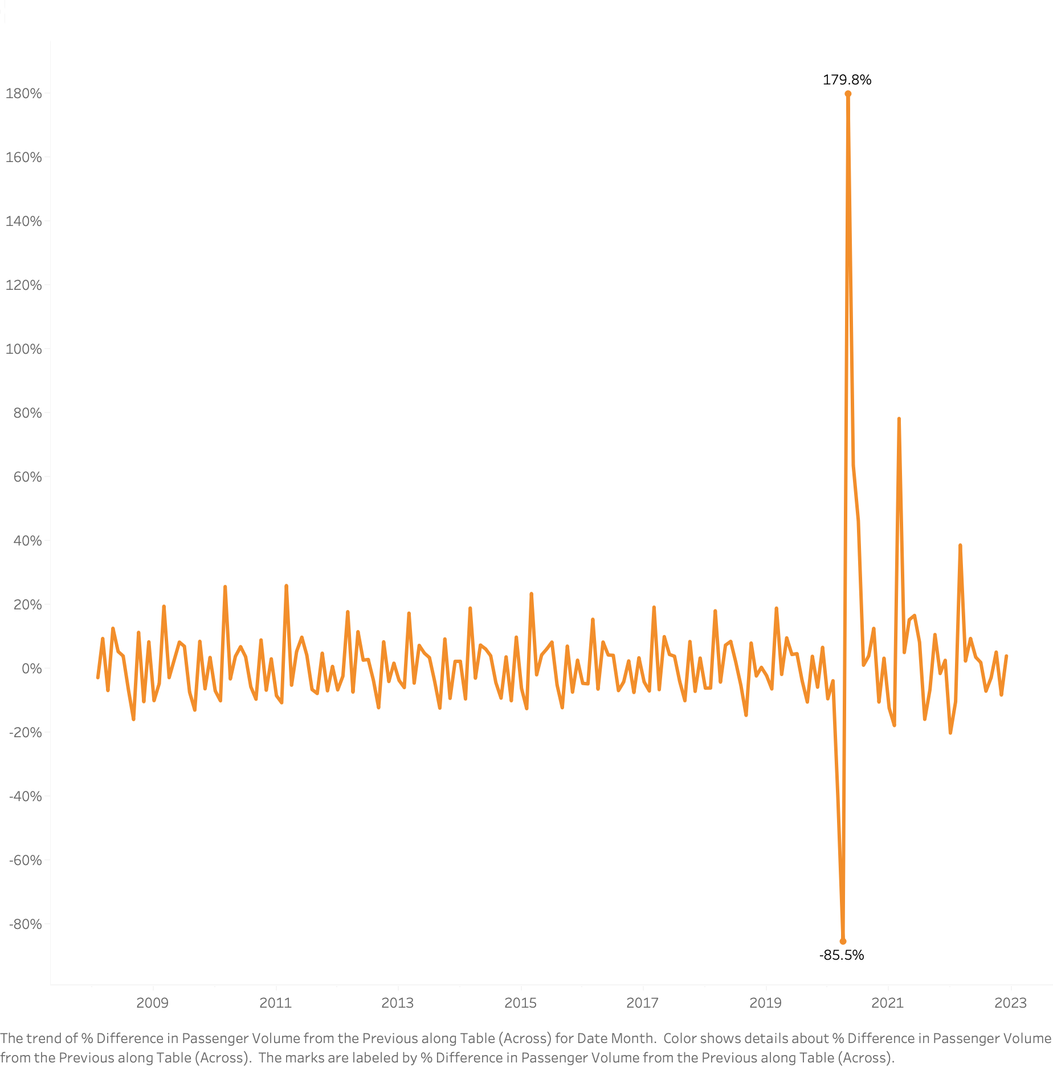



3
HISTORICAL DATA ANALYSIS
179.8%
MAY,2020
COVID-19 Factor
Growth Rate by Month
Without
With
AAGR
2.55%
AAGR
4.05%
-85.5%
APR,2020
CAGR
2.52%
CAGR
1.81%
COVID-19 has a significant impact on the passenger traffic.
Notes:
从图中可以看到，Covid-19对于客流量变化产出了重大影响，这也是我们在下一步分析工作中需要重点考虑的问题

Slide 12




4
ASSUMPTION
Assumptions
Approaches
Method: Prediction based on data from 2008-2019.
TOOL: Tableau
No impact from COVID-19.
The impact of COVID-19
concludes by the end of 2023.
Method: Add the COVID-19 impact factor.
TOOL: SARIMA (Python)
The impact of COVID-19 gradually diminishes but persists over the long term.
Method: Set a decay factor(Based on Method 2).
TOOL: SARIMA (Python)
Method: Introduce a GDP impact factor (Based on Method 3).
TOOL: SARIMA (Python)
What will happen if we
introduce new factors?
Notes:
从图中可以看到，Covid-19对于客流量变化产出了重大影响，这也是我们在下一步分析工作中需要重点考虑的问题 We need to provide assumptions, and based on them, develop our forecasting models.
达拉斯-沃斯堡都会区（Dallas-Fort Worth Metroplex）主要包括以下几个县：
1. **达拉斯县（Dallas County）**
2. **塔兰特县（Tarrant County）**
3. **科林县（Collin County）**
4. **登顿县（Denton County）**

Slide 13
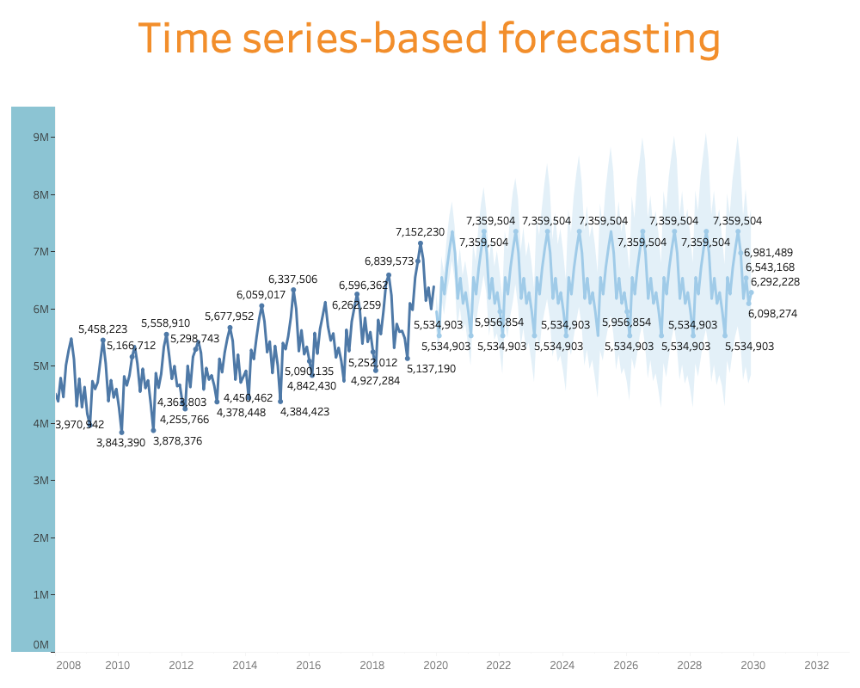
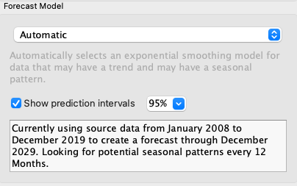
5
TABLEAU FORECASTING RESULT
Tableau
Based on Assumption 1,
ignoring the COVID-19
factor.
Result
Ignoring the COVID-19 factor and projecting patronage growth over the next ten years (120 months) , the prediction result did not turn out well.
Notes:
首先，我们尝试了Tableau的预测功能，这里仅考虑历史数据的长期趋势和周期波动，可以看到Tableau本身偏重数据分析，预测功能比较简单，对未来数据预测也非常保守。

Slide 14
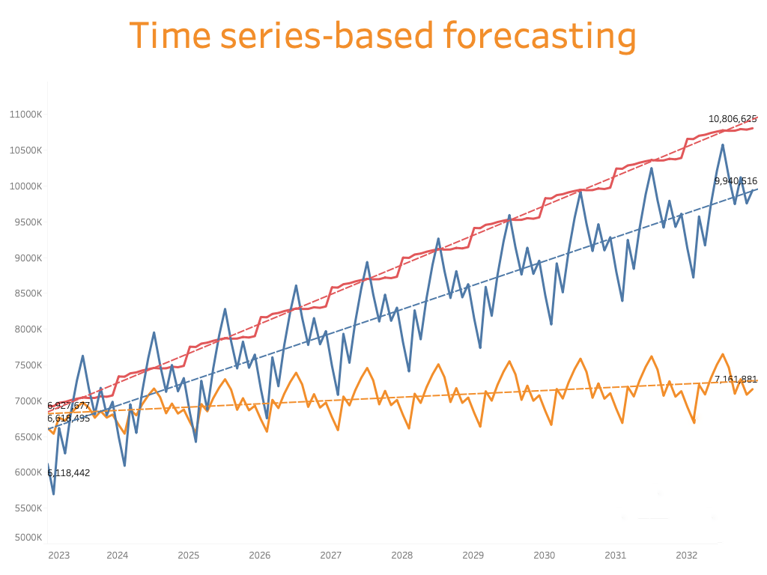
6
SARIMA FORECASTING
Assumption 2: Blue Line
Add COVID-19 factor
Code Source：Prophet-V1.py
SARIMA(Python)
PREDICTION MODEL
Assumption 3: Yellow Line
Set Decay factor
Code Source：Prophet-V2.py
Assumption 2
Assumption 3
Assumption 4
Assumption 4: Red Line
Add Regional GDP factors
Dallas-Fort Worth Metroplex
Data Source: U.S. Bureau of Economic Analysis (BEA) 2011-2021.
Code Source：Prophet-V3.py
CONCLUSION：
Upon comparing these 4 approaches，integrating COVID-19 impacts with GDP growth data enhances the accuracy of long-term trend forecasts.
Notes:
以下是采用SARIMA对数据预测的结果，一共迭代了三个版本：
版本 1: 考虑历史数据的长期趋势和周期波动，同时考虑covid 19 因素，假定covid 19 的影响持续至2023年底，之后恢复到2020年之前到增长水平。
版本 2: 在前一个版本上进行优化，考虑到covid 19 的影响不会在某个时间点突然消失，而是一个影响力逐渐衰减的过程，因此设置了一个衰减系数，使用线性回归模型来估计2019年12月之前（即认为是新冠疫情（COVID-19）影响前）的旅客人数数据趋势，以计算衰减系数（decay factor）。衰减系数是实际旅客人数与线性趋势预测旅客人数之间的比率，用于反映实际数据与趋势之间的偏差。
版本3: 在版本2 的基础上继续优化，加入了地区GDP增长因素。
数据来自美国经济分析局（BEA）2011-2021。
美国达拉斯-沃斯堡都会区（Dallas-Fort Worth Metroplex）主要包括以下几个县：
1. 达拉斯县（Dallas County）
2. 塔兰特县（Tarrant County）
3. 科林县（Collin County）
4. 登顿县（Denton County）

Slide 15
4
CHALLENGES &
PROJECT REVIEW
Part
Notes:
最后，总结并展望一下我们的工作

Slide 16



1
CHALLENGES: ETL
EXTRACT
TRANSFORM
LOAD
Economic Indicators
Tourism Trends
Aviation Developments
Demographic Statistics
Competitors
Data Cleaning
Data Merging
Duplicates & Missing values
Data Format Conversion
Calculated Fields
Relational Databases
Data Warehouses
Data Lakes
Notes:
Great journeys usually start with hard work. In the field of data analytics, this usually means ETL.
Historical Data
Past passenger flow data, seasonal variations, and trend analysis
Economic Indicators
In addition to GDP growth, other metrics such as unemployment, income, and consumer confidence indexes
Aviation Developments
New flight routes, ticket price
Demographic Statistics
Includes age structure, income level, and population density.
Tourism Trends
Special events can lead to increased traffic. Dallas is the host city for the next World Cup, which is expected to generate significant traffic.

Slide 17
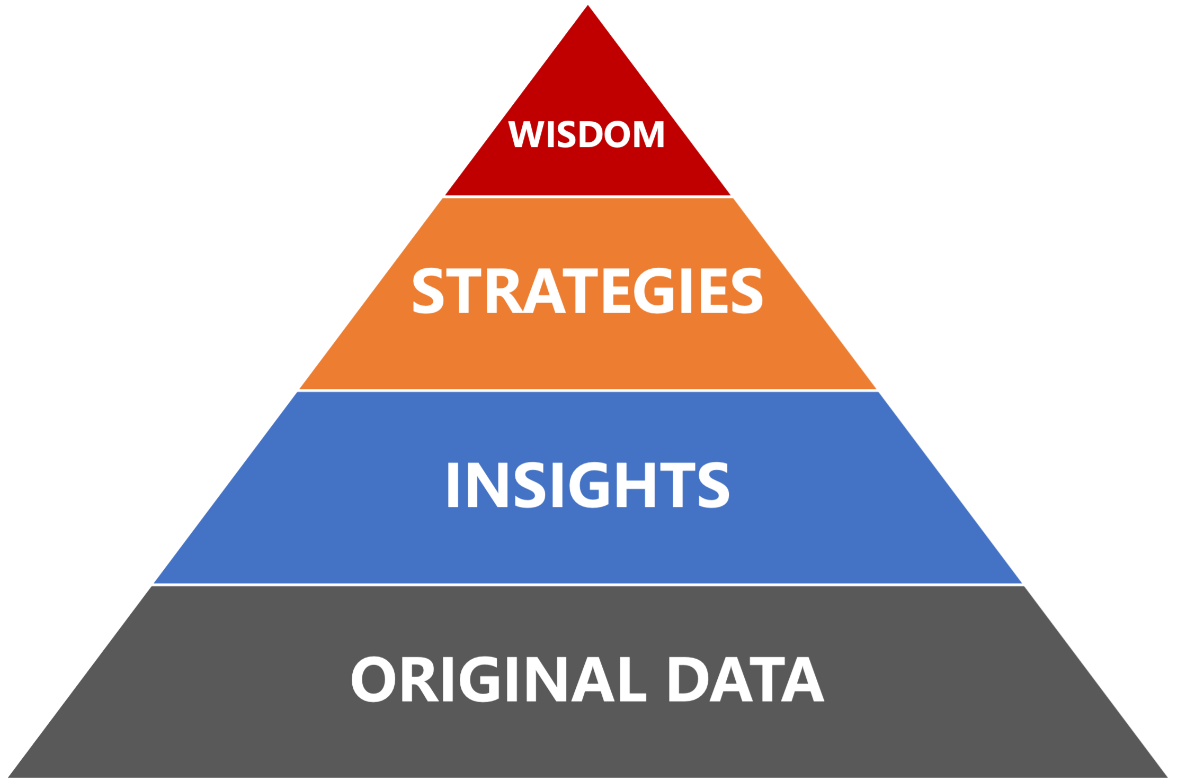
2
PROJECT REVIEW
STRUCTURED THINKING
BUSINESS UNDERSTANDING
DATA SENSITIVITY & INSIGHT
TOOLS & SKILLS
Notes:
Data analysts must have 4 types of capabilities:
1) problem disassembly ability or structured thinking;
Each question could be divided into 3 parts： range， dimension， aggregate measure
e.g： Calculation of the average annual growth rate of total passengers for 2008-2022
2) data sensitivity and insight; Date Modeling
3) Toolkit and skills： SQL, Tableau, Excel, Python, and knowledge of databases;
4) Business understanding.

Slide 18

Q&A
Notes:
Thanks

